Slide 1
ECE 537/CIS 568 Data Mining, Fall 2023 Project Title : Prediction of Dementia
STUDENTS
Mythresh Neerugattu

Slide 2
Contents:
1.Introduction
2.Data Descrption
3.Background
4.Methodology
5.Results
6.Discussion
7.Conclusion
8.Future Work
9.References

Slide 3
Introduction
Dementia in Contemporary Healthcare:
Formidable challenge impacting millions globally
Progressive cognitive decline with life-altering consequences
Urgency for early intervention to mitigate debilitating effects
Mission and Objective of Our Project:
Driven by the mission to revolutionize dementia prediction
Acknowledging the transformative potential of early diagnosis
Enhancing the lives of those affected by dementia
Primary Goal of Our Project:
Addressing dementia as a significant and escalating health concern
Emphasizing the critical role of early diagnosis for effective intervention and care

Slide 4
Data Description
Core Dataset from OASIS Database:
Diverse and rich dataset at the heart of our initiative
Meticulously curated from the OASIS database
Encompasses neuroimaging data, clinical assessments, demographics, and cognitive scores
Leveraging OASIS Dataset for Early Detection:
Leveraging the multidimensional OASIS dataset
Provides a holistic view of the complexities of dementia
Aspiring to contribute to early detection and enhance overall quality of life for individuals with dementia
Dataset Overview:
Longitudinal collection of data
Involves 150 subjects aged 60 to 96 years
Two or more imaging sessions per subject
A total of 373 imaging sessions

Slide 5
Data Description
MRI Scans:
Each subject contributes 3 or 4 individual T1-weighted MRI scans
Scans obtained in single scan sessions
Demographic Details:
Subjects include both men and women
All subjects are right-handed
Dementia Characteristics:
72 subjects remained nondemented throughout the study
64 subjects initially characterized as demented
51 of them with mild to moderate Alzheimer’s disease
14 subjects transitioned from nondemented to demented
Study Significance:
The longitudinal nature allows for a comprehensive exploration of aging, dementia, and neurodegenerative diseases
Provides a rich source of data for understanding cognitive changes and disease progression

Slide 6
Methodology
Data Preprocessing:
Handling Missing Values: Continue using the KNN imputer for handling nan and null values. Explore additional imputation techniques if necessary for specific types of data.
Outlier Management: Apply your capping techniques to outliers and consider using statistical methods like Z-score or IQR (Interquartile Range) for more nuanced outlier detection and handling.
Feature Engineering:
F-Statistics for Feature Selection: Stick to using F-statistics to identify the most significant features. This could be complemented with other techniques like mutual information or correlation analysis for a more comprehensive feature selection process.
Focus on Top Features: Maintain the focus on the top 8 features identified as most relevant for dementia prediction, ensuring the model is not overburdened with irrelevant or redundant data.
Model Development:
Diverse Models: Continue building a variety of machine learning models like Logistic Regression, KNN, SVM, Random Forest, and Kernelized SVM. This approach ensures a broad spectrum analysis and caters to different aspects of the dataset.
Model Comparison and Selection: Evaluate each model's performance and select the one(s) that best fit the data and the prediction goals.

Slide 7
Methodology
Model Evaluation:
Cross-Validation: Rigorously validate models using cross-validation to ensure their reliability and generalizability.
Performance Metrics: Assess models based on key metrics like accuracy, recall, precision, and F1 score. This comprehensive evaluation helps in understanding each model's strengths and weaknesses.
Performance Visualization:
Comparative Analysis: Visually compare the models by plotting their performance metrics. Tools like confusion matrices, ROC curves, and precision-recall curves can be particularly insightful.
Interpretation and Insights: Use these visualizations to gain insights into each model's performance, aiding in the final selection of the most effective model for dementia prediction.

Slide 8
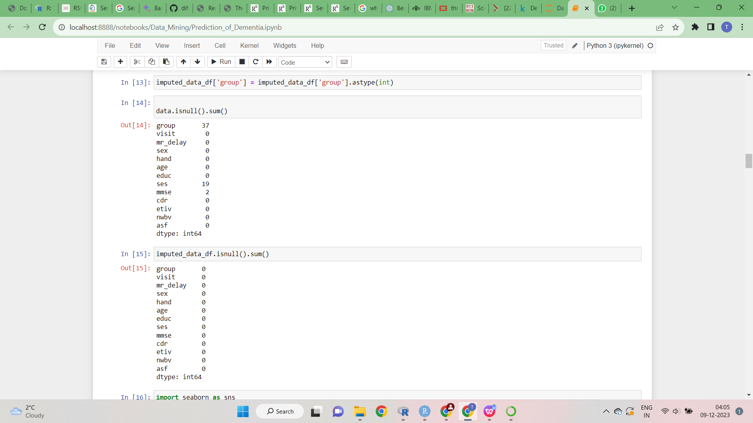
Results
The handling of null values was addressed meticulously using the KNN imputer. This method estimates missing values based on the similarity of neighboring data points, thereby preserving the underlying structure and relationships within the dataset. This approach ensures data integrity and completeness, which is crucial for the accuracy and reliability of the subsequent analysis in dementia prediction.
KNN imputer

Slide 9
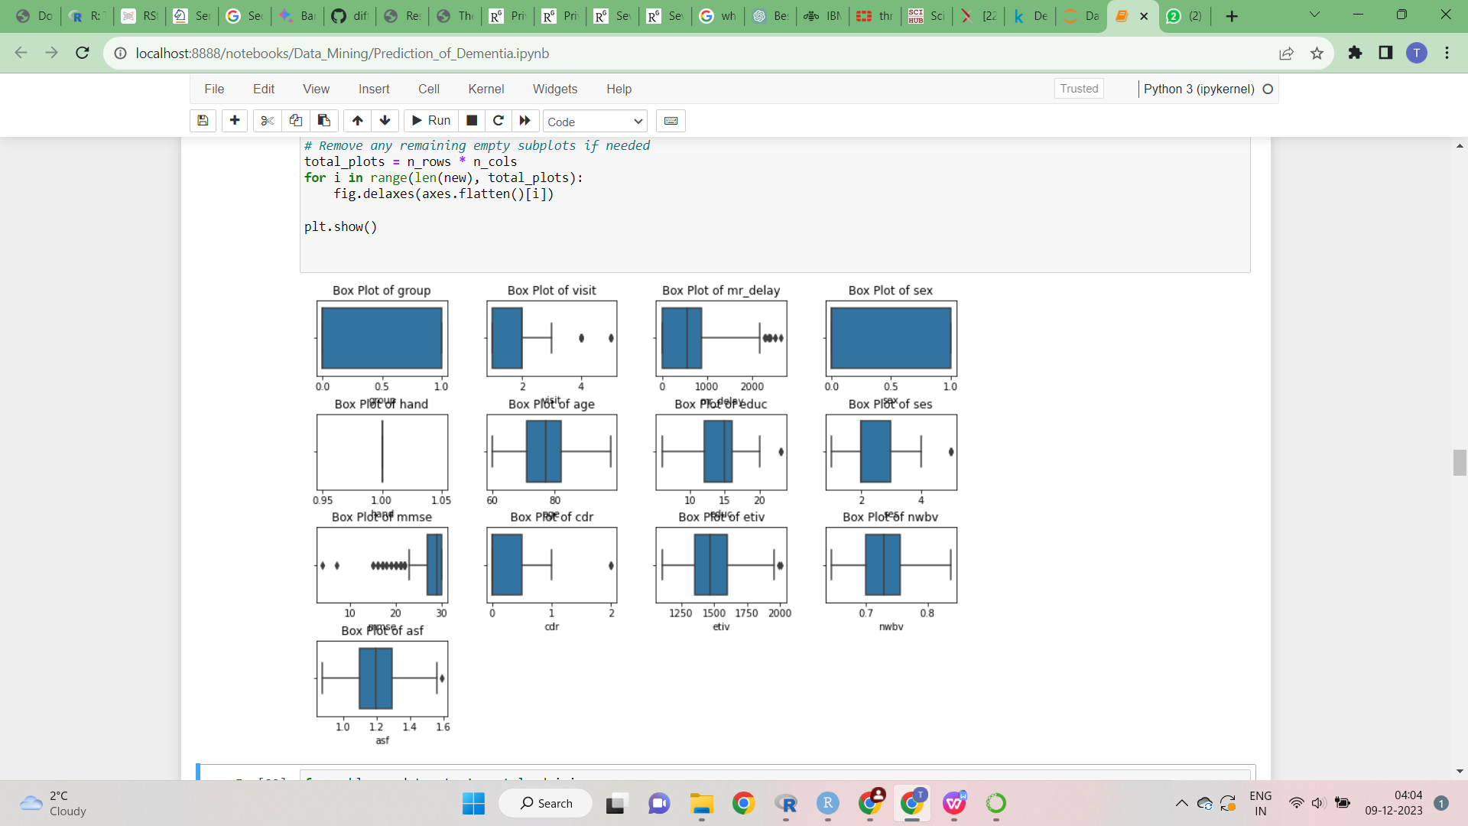
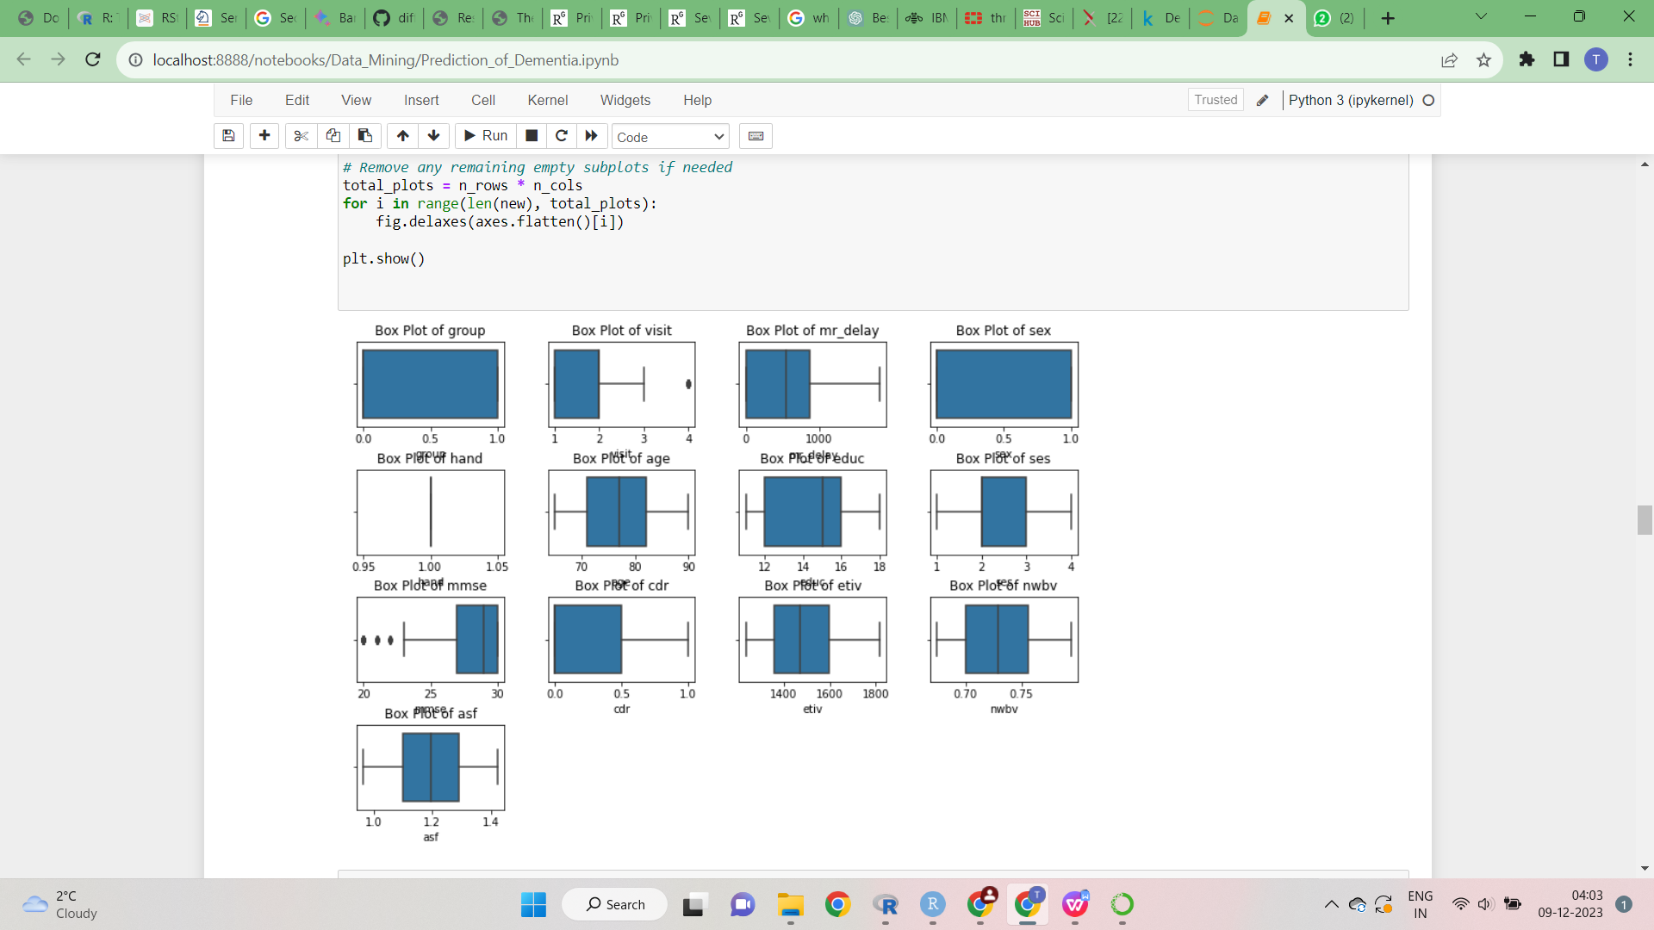
Results
For managing outliers in your project, capping techniques were strategically employed. This method involved setting thresholds to identify and limit extreme values, thereby mitigating the potential skewing effect of outliers on the dataset.
Before After

Slide 10
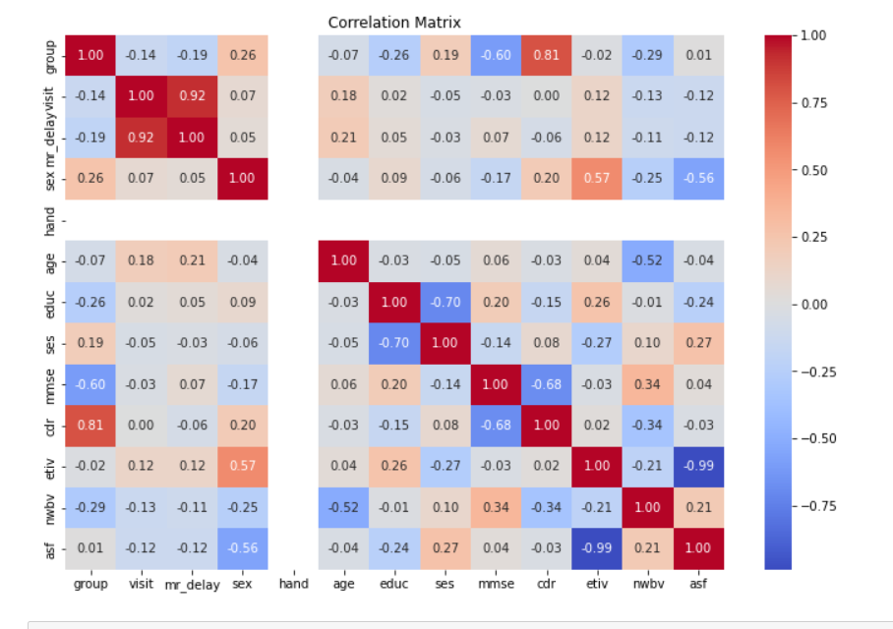
Results
In this dementia prediction project, correlation analysis was utilized to understand the relationships between different variables. This analysis helped in identifying which variables are most strongly associated with dementia outcomes, enabling a more focused and effective feature selection for predictive models.

Slide 11
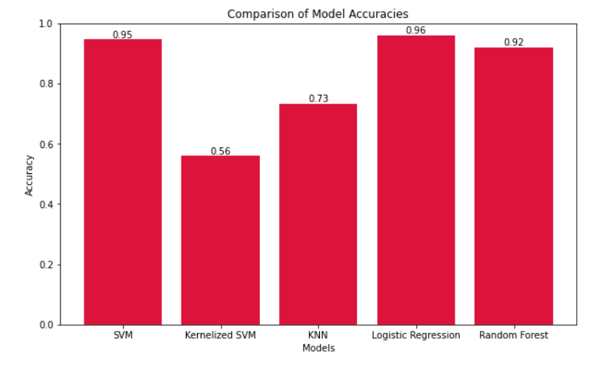
Results
The SVM model shows a high accuracy of 0.95, indicating its strong predictive performance. Logistic Regression surpasses this slightly with an accuracy of 0.96, while the Kernelized SVM has the lowest at 0.56, suggesting it may be less suitable for this particular dataset or problem.

Slide 12
Discussion
In our dementia prediction endeavor, we encountered significant challenges during the data preprocessing stage. Initial techniques such as row removal and mean imputation adversely affected our model's performance due to critical data loss and introduction of bias.
The adoption of KNN imputation marked a turning point, leveraging the nearest neighbors' data to enhance accuracy through more representative imputation.
Our approach to outliers was similarly nuanced; rather than eliminating them, we applied a capping strategy at the 5th and 95th percentiles. This preserved valuable data while mitigating the distortion from extreme values, thus contributing to the refinement of our dataset and the efficacy of our models.
When we looked at different machine learning methods, we found that they didn't all work the same. The Kernelized SVM, which used a special method called RBF kernel, did not do well with our data. But when we used another method called a polynomial kernel, it did better, though still not as good as some other methods we tried. This shows that choosing the right method is very important for making good predictions with medical data.

Slide 13
Conclusion
In conclusion, our project’s primary goal was to determine the most effective machine learning approach for predicting dementia. Through our research, we discovered that Logistic Regression, not the initially favored SVM and Kernelized SVM models, proved to be the most accurate. This finding underlines the importance of thorough data preparation, which significantly enhanced our model’s performance.
We also recognize the critical ethical considerations in handling healthcare data, emphasizing the need for privacy and responsible data management. While our project demonstrates the valuable insights computational methods can offer in healthcare, it’s important to remember that these tools are not infallible and should be used with care.
Looking forward, we advocate for increased collaboration between scientists, medical professionals, and data analysts. Such teamwork is essential for advancing our understanding of complex medical conditions like dementia. Ultimately, our project not only showcases the potential of data analysis in healthcare but also highlights the need for ethical practices, careful data preparation, and collaborative efforts in shaping the future of medical research and treatment.

Slide 14
Limitations and Future Work
The model performance could be further improved by exploring additional features and data sources.
Developing Explainable AI (XAI) techniques could enhance model interpretability and provide insights into the underlying disease mechanisms.
Validating the model on external datasets is crucial for ensuring generalizability and real-world applicability.
Implementing the model for clinical decision support and personalized medicine approaches could significantly impact dementia management.

Slide 15
References
[1] Hastie, T., Tibshirani, R., & Friedman, J. (2009). The Elements of Statistical Learning: Data Mining, Inference, and Prediction. Springer. ISBN 978-0387848570.
[2] Bishop, C. M. (2006). Pattern Recognition and Machine Learning. Springer. ISBN 978-0387310732.
[3]Fischl,B.(2012).FreeSurfer.NeuroImage,62(2),774781.doi:10.1016/j.neuroimage.2012.01.021.
[4] Ashburner, J., & Friston, K. J. (2000). Voxel-based morphometry—The methods. NeuroImage, 11(6), 805-821. doi: 10.1006/nimg.2000.0582.
[5] Pedregosa, F., Varoquaux, G., Gramfort, A., Michel, V., Thirion, B., Grisel, O., ... & Duchesnay, É. (2011). Scikit-learn: Machine learning in Python. Journal of Machine Learning Research, 12(Oct), 2825-2830.
[6] McKinney, W., & others. (2011). Pandas: a foundational Python library for data analysis and statistics. Python for High Performance and Scientific Computing, 14(9).

Slide 16
THANK YOU

